Slide 1
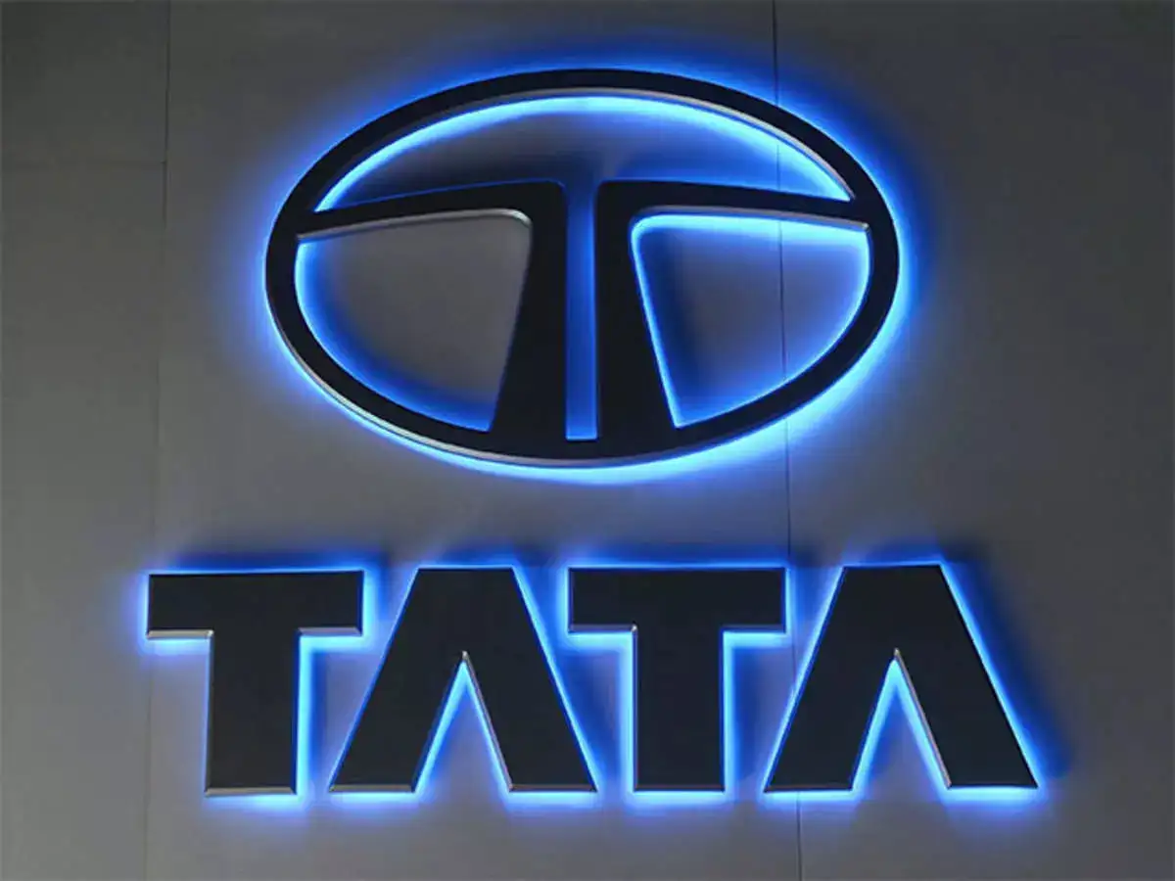

Marketing Campaign Proposal Tata Motors EV – Nexon EV (TASK 3: Marketing Campaign Design)
Submitted by: Ankit.
Student Id- CA/SE1/13745
Email-ankit13078@gmail.com
(Galgotias University)
Internship: CodeAlpha
(Business & Marketing Strategy)
October 2025 Batch

Slide 2
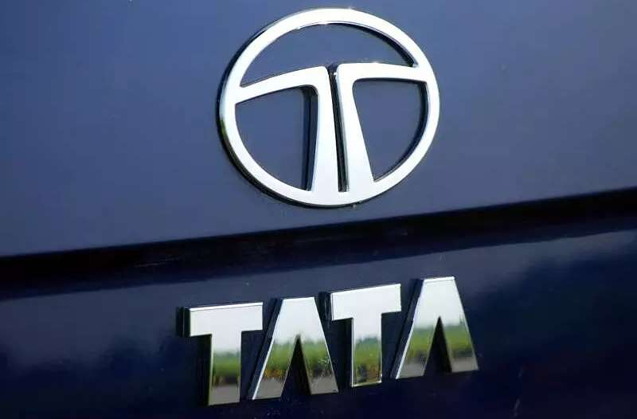
Introduction
Tata Motors is India’s largest EV manufacturer.
Nexon EV leads the electric car segment with strong sales.
Rising demand for sustainable transport in urban India.

Slide 3
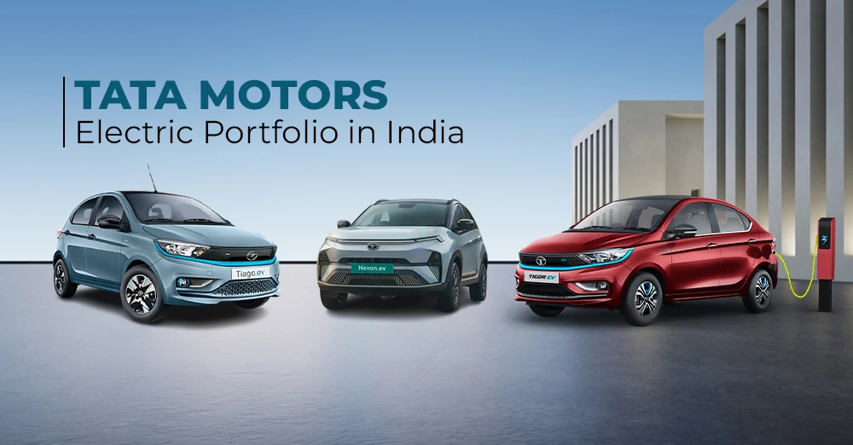
Campaign Objective
Create awareness of Nexon EV as the #1 urban EV.
Increase lead generation among young professionals.
Drive sales through targeted digital promotions.

Slide 4
Target Audience
Age group: 25–40 years.
Urban professionals and eco-conscious families.
Income group: ₹10–25 LPA.
Cities: Delhi, Mumbai, Bangalore, Pune.

Slide 5
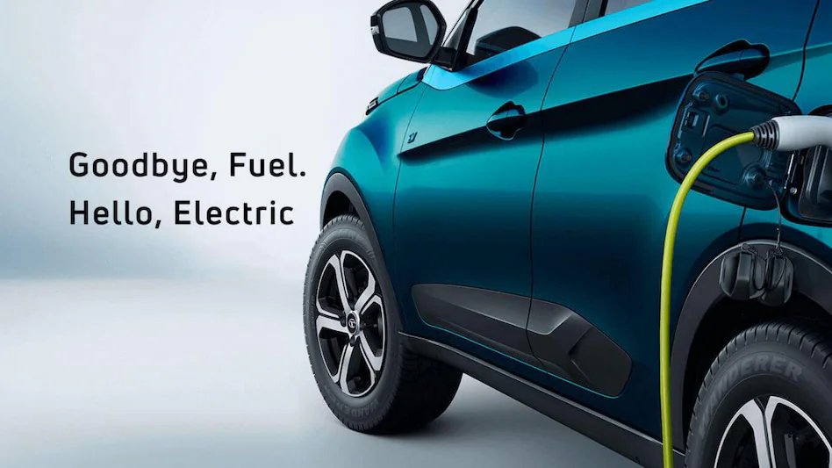
Social Media Plan
Instagram: Reels showcasing lifestyle + EV benefits.
LinkedIn: Professional posts on sustainability.
YouTube: Influencer test drive & ad films.
Twitter/X: Daily EV facts + CSR updates.

Slide 6
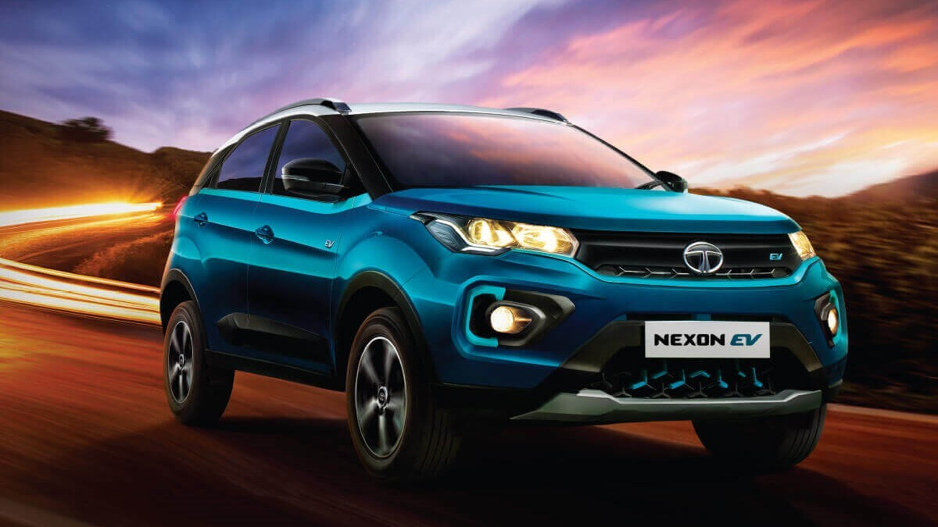
Ad Strategy
Facebook & Google ads targeting metro cities.
Influencer tie-ups with auto & lifestyle bloggers.
On-ground “EV Experience” test drive events.

Slide 7
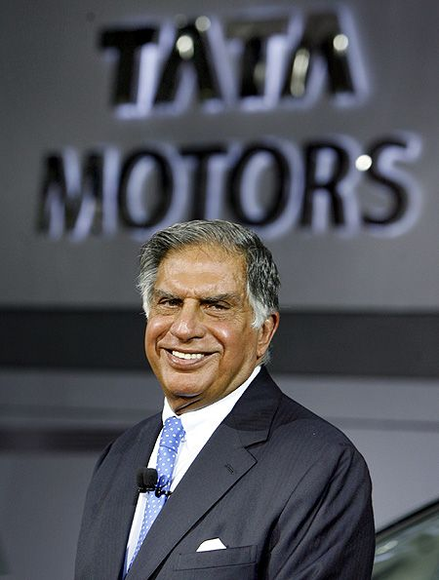
Budget Estimation
Activity | Budget (INR)
Social Media Ads | 15 Lakhs
Influencer Marketing | 10 Lakhs
Events & Test Drives | 5 Lakhs
Total | 30 Lakhs

Slide 8
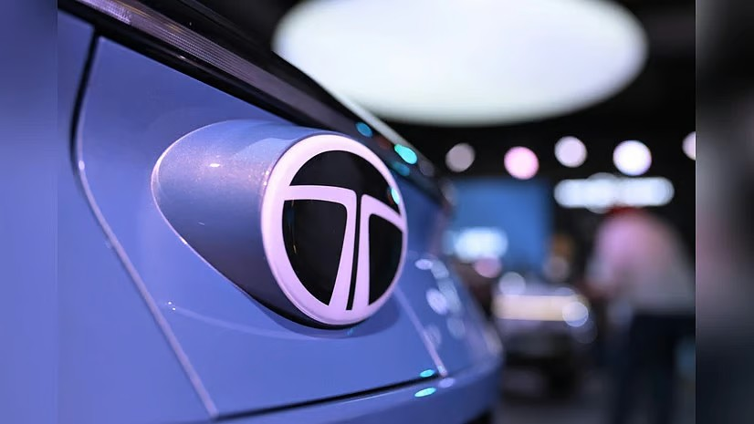
Expected Outcomes
5 Million+ Impressions.
20,000+ qualified leads.
5% conversion → 1,000 EVs sold.
Strengthen Tata’s eco-friendly brand image.

Slide 9
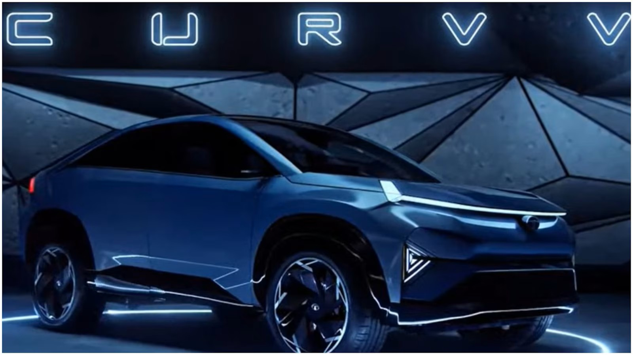
Timeline
Month 1: Awareness (ads + influencer collab).
Month 2: Lead generation (forms + offers).
Month 3: Conversion events (test drives + financing).

Slide 10
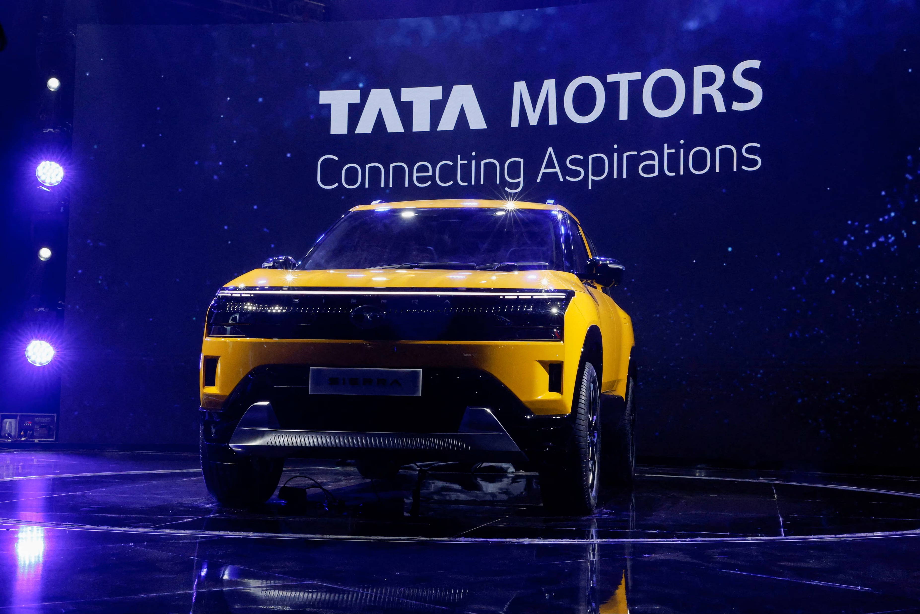
Month | Activity
Month 1 | Awareness (Ads + Influencers)
Month 2 | Lead Generation (Forms + Offers)
Month 3 | Conversion Events (Test Drives + Financing)
Awareness
Lead
Conversion

Slide 11
Conclusion
Nexon EV positioned as India’s go-to urban electric car.
Campaign integrates digital + on-ground promotions.
Strong potential for sales growth and brand leadership.

Slide 12
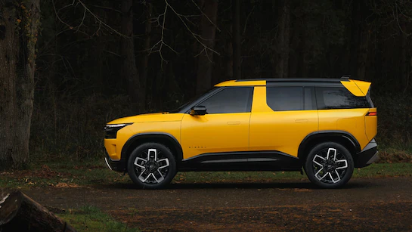
Thank You!

